Slide 1
Objectives
Identify the functions of a spreadsheet
Identify how spreadsheets can be used.
Explain the difference in columns and rows.
Locate specific cell references.
List the types of data that can be put into a spreadsheet.
Input a formula for adding and averaging data.

Slide 2
What is a Spreadsheet?
A program that allows you to use data to forecast, manage, predict, and present information.

Slide 3
Spreadsheet Uses
School: Student grades, payroll
Sports: individual and team statistics
Personal: checkbook, household expenses
Business: payroll, investments

Slide 4
Introduction to Excel
Spreadsheets are made up of :
columns – identified with alphabetic headings
rows - identified with numeric headings
and their intersections are called cells
(Cell references: B4, A20)

Slide 5
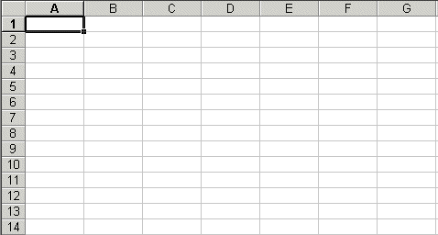
A1
Columns
B3
E7
Rows

Slide 6
Introduction to Excel
In each cell there may be the following types of data
text (labels)
number data (constants)
formulas (mathematical equations that do all the work)

Slide 7
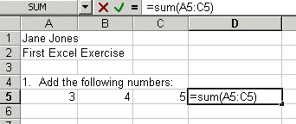
Data Types
Text
Data
Formulas

Slide 8


Formulas ALWAYS begin with an = sign. This “tells” Excel that a calculation will need to be performed.
Reference cells, NOT the numbers in them!

Slide 9
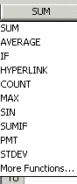
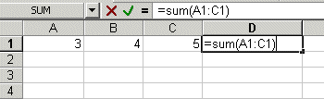
Built in Functions
=sum
:
Use of colon = “through”

Slide 10


To change column width:
Put cursor on line between two columns and drag to the right to the desired width

Slide 11
Familiar Toolbar
Graph Wizard

Slide 12
Exercise #1:
Open Excel
Change column widths
Change row height
Identify cell references
Type in text
Type in numbers
Add numbers
Average numbers

